Slide 1
DevOps & Cloud Infrastructure SEIS 665 Week 13
Jason Baker
Adjunct Instructor
Graduate Programs in Software
University of St. Thomas
St. Paul, MN

Slide 2
Agenda
Service discovery
Consul
Container orchestration
AWS ECS
Kubernetes
Docker Swarm
Final

Slide 3
Service Discovery
How do we connect services together in dynamically deployed infrastructure?
Example: Web service needs to bind to database service, so the web services needs to know the network location of the database service.
A microservices architecture heavily leverages service discovery:
Potentially needs to track dozens or hundreds of services.
Route requests to services based on availability.
Active/active, active/passive, etc.
May need to support service versioning.
Adjust service requests based on infrastructure topology changes.
Container or instance failure, auto-scaling

Slide 4
Service Discovery
How do we discover services?
Traditionally we would hard-code service locations because infrastructure didn’t change often.
Use outputs from Infrastructure definition tools to determine service location.
Problem: Tooling doesn’t update locations when infrastructure fails.
Dedicated service discovery platform.
Source: http://www.slideshare.net/scaganoff/service-discovery-with-consul

Slide 5
Service Discovery Platform

Slide 6
Traditional service discovery
Domain Name Services
Discover the IP address of a system based on a name.
Not designed for dynamic infrastructure changes.
Unix /etc/services
Maps port numbers to service names.
Distributed file systems and databases (lock servers)
Leader election
Source: http://www.slideshare.net/scaganoff/service-discovery-with-consul

Slide 7
Lock servers
Lock servers allow a group of nodes to synchronize activities and agree on shared information.
Very challenging to synchronize services in a distributed architecture due to issues like race conditions.
Participant nodes elect a leader and the nodes discover one another.
Shared information is stored as meta-data across all nodes.

Slide 8
RAFT Algorithm
Commonly used algorithm for leader election and storing state in a distributed system.

Slide 9
Apache ZooKeeper
Originally started as a project at Yahoo, now a part of Apache Foundation.
Sub-project of Hadoop, but now a top-level project.
https://zookeeper.apache.org/
A distributed hierarchical key-value store.
Distributed configuration service
Data synchronization service
Naming registry
Source: https://en.wikipedia.org/wiki/Apache_ZooKeeper

Slide 10
etcd
Distributed consistent key-value store for shared configuration data.
Written in Go and maintained by CoreOS team.
https://github.com/coreos/etcd
Commonly used in container-based clusters (i.e., Kubernetes).
etcd service runs in a clustered configuration, and nodes can talk to the cluster to set or retrieve configuration data.

Slide 11
Consul
Service discovery system designed by HashiCorp.
Consul agents run as a server or a client.
Servers form a cluster using Raft algorithm.
Clients proxy requests to servers.
Distributed key/value store.
Supports health checks to route requests around unhealthy hosts.
Offers both HTTP and DNS interfaces.

Slide 12
Consul architecture
Nodes run a Consul agent.
Communicate with one or more servers.
Responsible for health checks of services on the node.
Consul servers store and replicate data.
Servers form a cluster and elect a leader.
3 to 5 servers recommended to avoid failure scenarios leading to data loss.

Slide 13
Consul architecture

Slide 14
Consul data consistency
Data reads are strongly consistent.
key/value data is consistently replicated across cluster.
Availability is sacrificed for consistency in the case of a network partition.
Can no longer write data if there is no quorum.
Avoid situations where configuration data is different on one server versus another.
Recall the CAP Theorem!

Slide 15
Consul Service Registration
A node running a Consul agent registers a service using a service registration file.
JSON file containing key/value data
Commonly located in /etc/consul.d
# example webserver service registration
{“service”:
{“name”: “webserver”,
“tags”: [“nginx”],
“port”: 80
}
}

Slide 16
Querying Consul
Once a service is registered, any other service can query Consul to find it.
Using DNS:
dig @dns-server -p 8600 webserver.service.consul
Using HTTP:
curl http://consul:8500/v1/catalog/service/webserver

Slide 17
Health Checks
We can also create service definitions to perform health checks:
service": {"name": "webserver",
"tags": [”nginx"],
"port": 80,
"check": {"script": "curl localhost >/dev/null 2>&1", "interval": "10s”
}
}
}
If the executable script returns a non-zero exit code, the service will be flagged unhealthy.
Consul won’t list unhealthy services in typical queries.

Slide 18
Consul Key/Value Store
Two ways to interact with Consul KV store:
HTTP API
Consul KV CLI
Get a value from the store:
consul kv get redis/config/minconns
Insert (or update) a value into the store:
consul kv put redis/config/minconns 1
Delete a key from the store:
consul kv delete redis/config/minconns

Slide 19
Orchestration
A set of processes which control the lifecycle of infrastructure resources.
Like CRUD operations on compute, storage, and network resources.
AWS Console and API, VMWare vCloud, Open Stack.

Slide 20
Container orchestration
How do we orchestrate containers?
Containers are like super-processes, not real servers.
A single compute instance could support many containers.
Modern apps dynamically create, update and destroy containers.
Need a way to provide high availability if a container or container host fails.
May need to distribute requests across a set of containers using a load balancer.

Slide 21
AWS Elastic Container Service (ECS)
A Docker container management solution that runs on top of EC2.
AWS deploys managed EC2 Docker host instances.
AWS automatically deploys your containers to the managed hosts.
AWS is gradually making its services container aware.
ELBs can load balance requests across a set of containers running on ECS.

Slide 22
AWS ECS
AWS EC2 Container Registry (ECR)
A private Docker image repository (like Docker Hub).
Advantage: It’s an AWS-supported service, integrated with other services.
Disadvantage: Fairly basic capabilities at this point and may not be suitable for complex requirements.

Slide 23
Kubernetes
Open-source container orchestration platform designed by Google.
Name originates from Greek, meaning “helmsman” or “pilot”.
Based on key technical principles Googles uses to scale its global platform.
Provides an abstraction layer to make container management and application deployment easier.

Slide 24
Kubernetes
Kubernetes manages clusters of computing instances.
Each cluster contains a master instance and multiple nodes.
Master manages resources and coordinates activities in the clusters.
Nodes run a Kubelet (agent) and a container engine (Docker).
Nodes communicate with master using an API.

Slide 25
Kubernetes

Slide 26
Kubernetes
Each app defined by an application deployment.
Specifies application container
How many copies (replicas) of the app to run
Kubernetes creates a Pod to host the app.
Pod = group of containers and shared resources
Pod runs on a node, and a node can have multiple pods.
A service is used to expose a set of pods to the outside world.

Slide 27
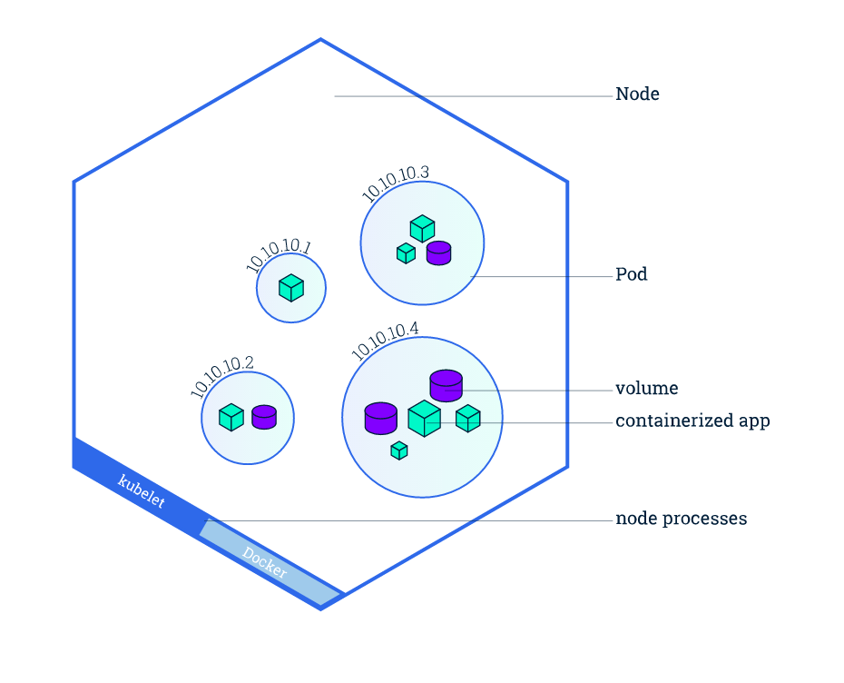
Kubernetes

Slide 28
Kubernetes

Slide 29
Docker Swarm Mode
Docker engine has an integrated cluster orchestration service (ver. 1.12+).
Previously a separate tool called Docker Swarm.
Manages a cluster of instances running Docker engine, called nodes.
Uses two types of nodes: managers and workers.
Node type is defined during deployment, so only one instance image is needed.
Typically we deploy one node per instance.
Follows a declarative approach: define the state of services in an application stack and Docker will try to achieve that desired state.

Slide 30
Docker Swarm Mode

Slide 31
Docker Swarm Mode
Swarm manager
Monitors cluster state and reconciles differences between actual and desired state.
Service discovery: assigns each service a unique DNS name and provides ingress load balancing.
Manages rolling updates of application containers within the swarm.
Swarm worker
Basically just runs Docker containers.

Slide 32
Docker Swarm Mode
We submit a service definition to a manager node, it dispatches tasks to workers.
Each task specifies a Docker container and the commands to run inside the container.
Define a service which represents a set of containers exposed via a network address.

Slide 33
Docker Swarm Mode

Slide 34
Swarm Hands-on
Create Docker swarm stack:
https://s3.amazonaws.com/seis665/docker-swarm.json
Creates one manager instance and multiple worker nodes.
Automatically initializes a Swarm cluster and subscribes all worker nodes to cluster.
Wait until stack creation is complete, then log into manager1 node.

Slide 35
Swarm Hands-on
Deploy a new service:
docker service create --replicas 1 \
--name helloworld alpine ping docker.com
Show the running service:
docker service ls
Inspect the running service:
docker service inspect --prety helloworld
Identity the node running the service:
docker service ps helloworld

Slide 36
Swarm Hands-on
Let’s scale the number of containers supporting our service:
docker service scale helloworld=5
Now take a look at the nodes running the service:
docker service ps helloworld
Some of the containers are running on the local host:
docker ps
We can remove the helloworld service:
docker service rm helloworld
Verify that the service is gone:
docker service inspect helloworld

Slide 37
Swarm Hands-on
Create a new service using Redis and perform an update:
docker service --replicas 3 --name redis \
--update-delay 10s redis:3.0.6
View the running service:
docker service ps redis
Update the service to Redis version 3.0.7:
docker service update --image redis:3.0.7 redis
Run the ps command several times to view the update:
docker service ps redis
After the updates complete, confirm the service status:
docker service inspect --pretty redis

Slide 38
Swarm Hands-on
Update the number of containers in the service:
docker service scale redis=5
New container instances are running the desired version:
docker service ps redis
Sometimes we need to remove a node for maintenance. Let’s drain a node:
docker service update --availability drain <node ID>
Take a look at the processes to watch that node drain:
docker service ps redis
Now let’s change the drained node back into an available node:
docker node update --availability active <node ID>

Slide 39
Homework
No homework this week.
Good luck on the final exam!

